Slide 1

Food recognition
A smart app that uses deep learning to track nutrition from food images

Slide 2
Overview
Recognizing food from images is an extremely useful tool for a variety of use cases. It would allow people to track their food intake by simply taking a picture of what they consume. Food tracking can be of personal interest and can often be of medical relevance as well. Medical studies have for some time been interested in the food intake of study participants but had to rely on food frequency questionnaires that are known to be imprecise.

Slide 3
Datasets
ISIA Food-500
Food Recognition Challenge on Kaggle
Food Recognition Challenge on Aicrowd
The Food and Food Categories (FFoCat) Dataset

Slide 4
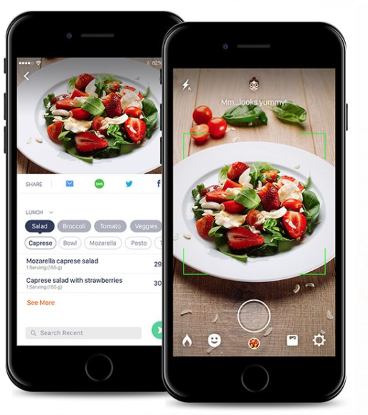
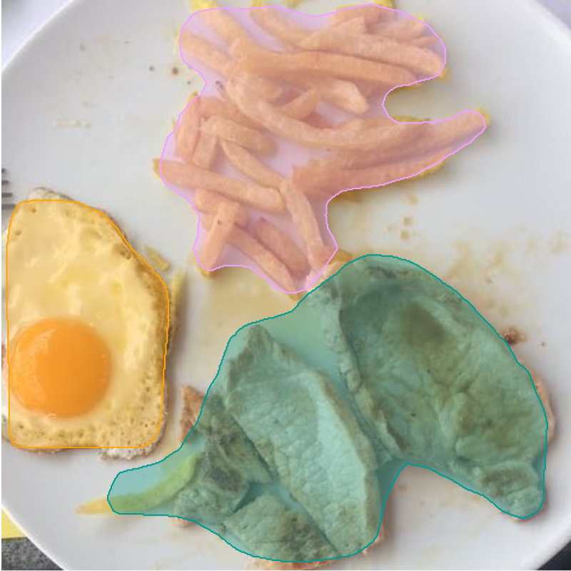
What we expect?

